Slide 1
King County Opportunity Youth
Young adults facing systemic
barriers from opportunity

Slide 2
Contacts
Sindhu Ravikumar
Paul Tanner
William Melville
Prabhakar Rangarao

Slide 3
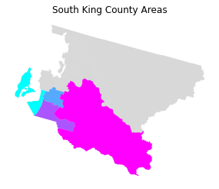
Map of
King County Area
Defined by PUMAs
Age between 16 and 24
No current employment
Not in school or any formal education
7,257 of Opportunity Youth in South King County in 2017
These are the lost workforce

Slide 4
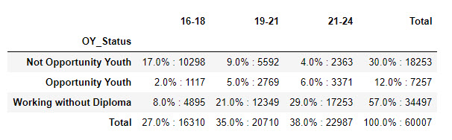
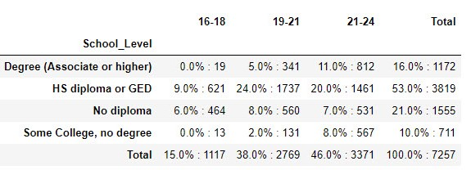
Education Stats of OY in
King County By Age Group

Slide 5
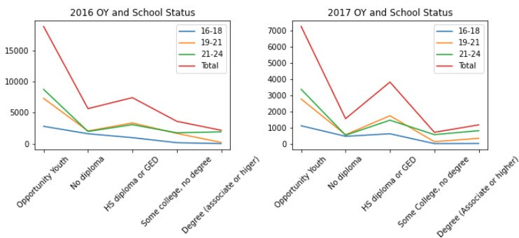
Opportunity Youth Education Levels of
2016 vs 2017

Slide 6
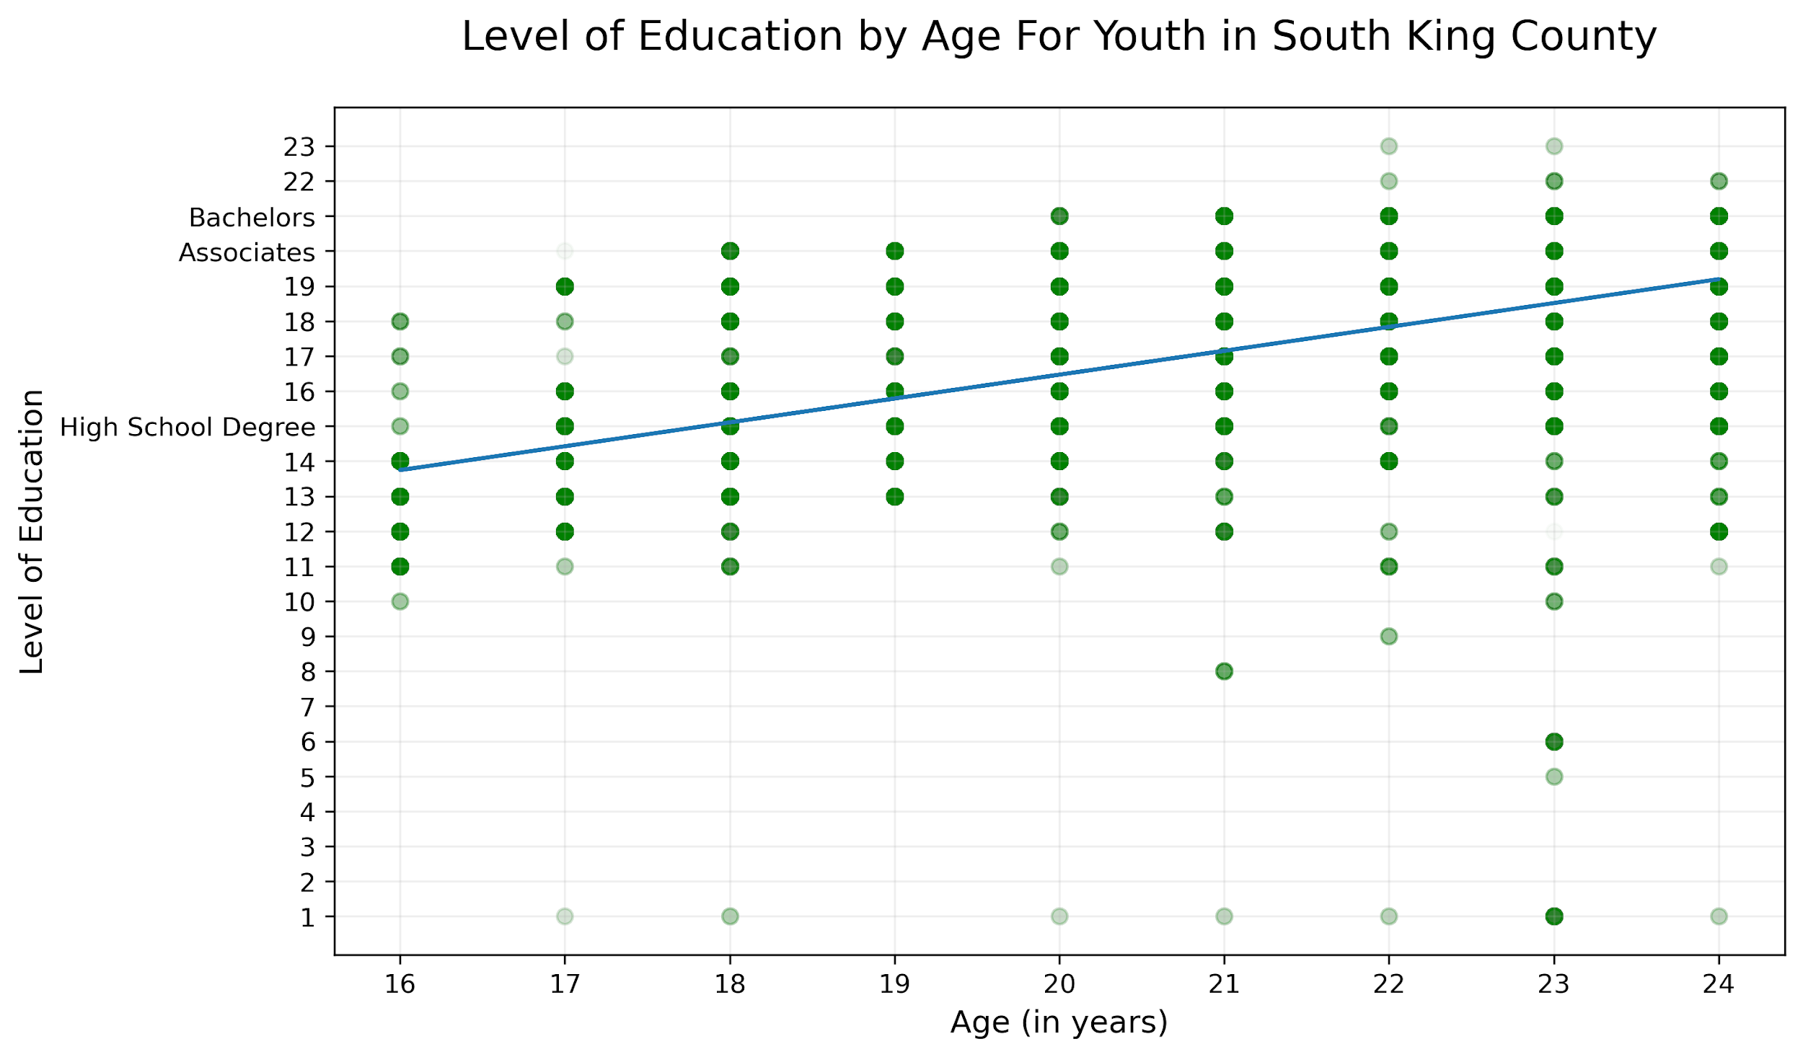
South
King County
Education
Levels
y= 0.33x+8.79
Notes:
M = 0.6322106141230123
B = 3.6587510631141167

Slide 7
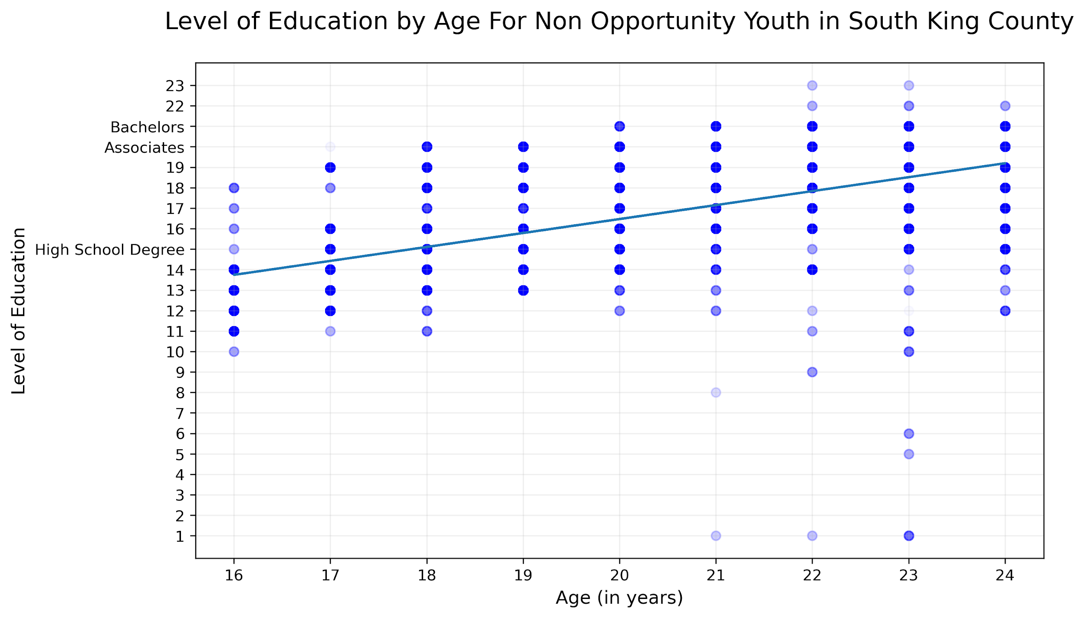
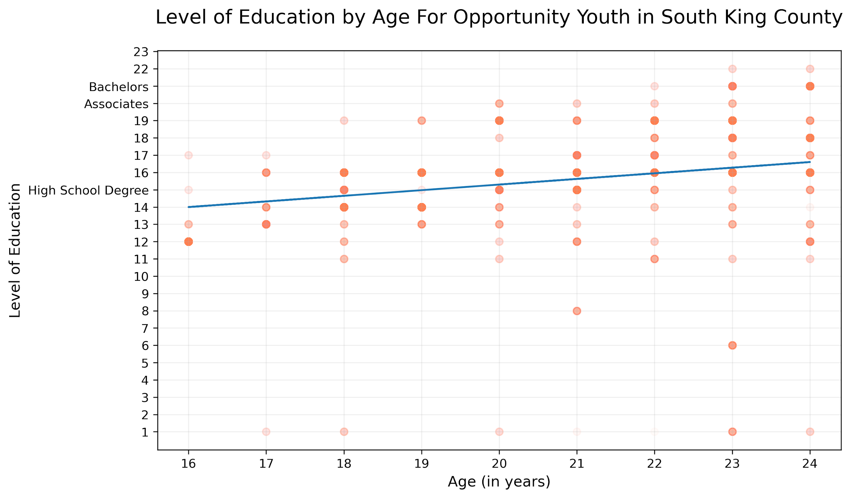
Breakdown of Education Level by Age
y=0.68x+2.84
OY are half as likely to continue education than their non Opportunity Youth counter parts
y=0.33x+8.79
Notes:
NON OY
B = 2.837979140855148251482
M = 0.6814773840095679
OY
M = 0.3255958473778856
B = 8.78762249272257

Slide 8
Notes:
M = 0.6814773840095679
B = 2.8379791408551482

Slide 9
Notes:
M = 0.3255958473778856
B = 8.78762249272257

